Slide 1
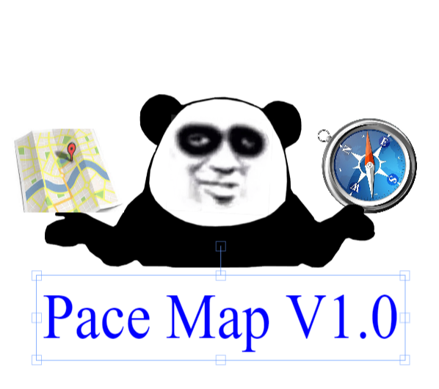
PACEMAP V1.0
Jiayue.Ma
https://github.com/paceuniversity/cs389f2021team9

Slide 2

Why I design this app
To Save time to find the classroom and office
To find something new or interesting at the campus
To find a space for your club activities
To know the changes at the campus
Future commercial

Slide 3

Target Users
Students at Pace
For professors and staffs
For the people who visit to our campus

Slide 4

Main Features
Search by maps
Search by index
Search by schools
View the transportation information

Slide 5

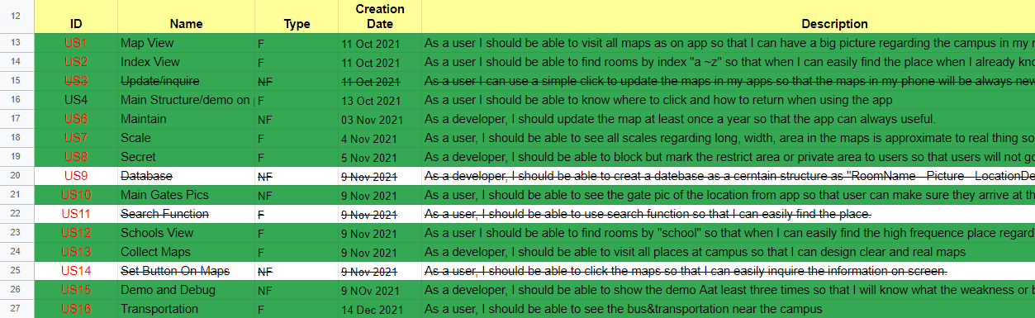
US and process

Slide 6

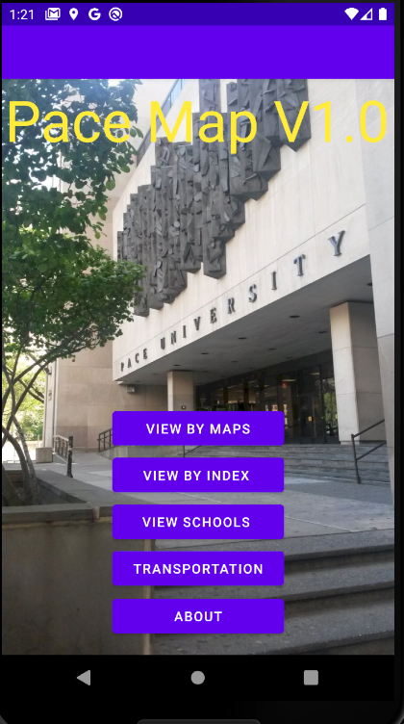
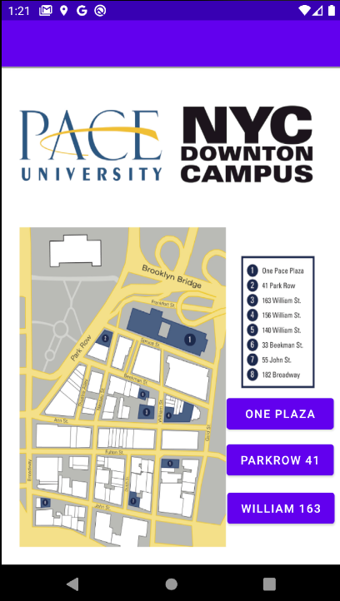
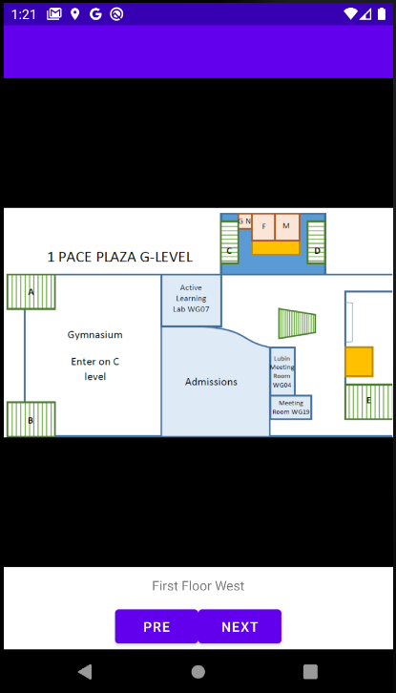
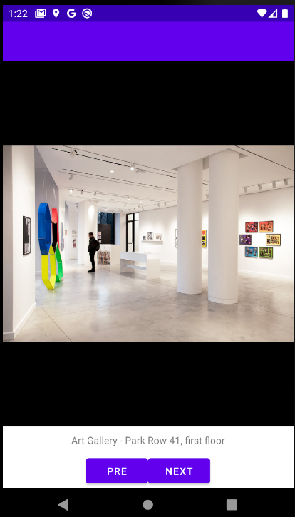
The Demo

Slide 7




Question

